Slide 1
Introduction to Arduino controlled by python

Slide 2
簡介
Arduino 是一種開源微控制器平台，常用於電子專案和自動化應用。Python 可以透過串列通信（Serial Communication）與 Arduino 互動，讓我們能夠以程式方式控制硬體。

Slide 3
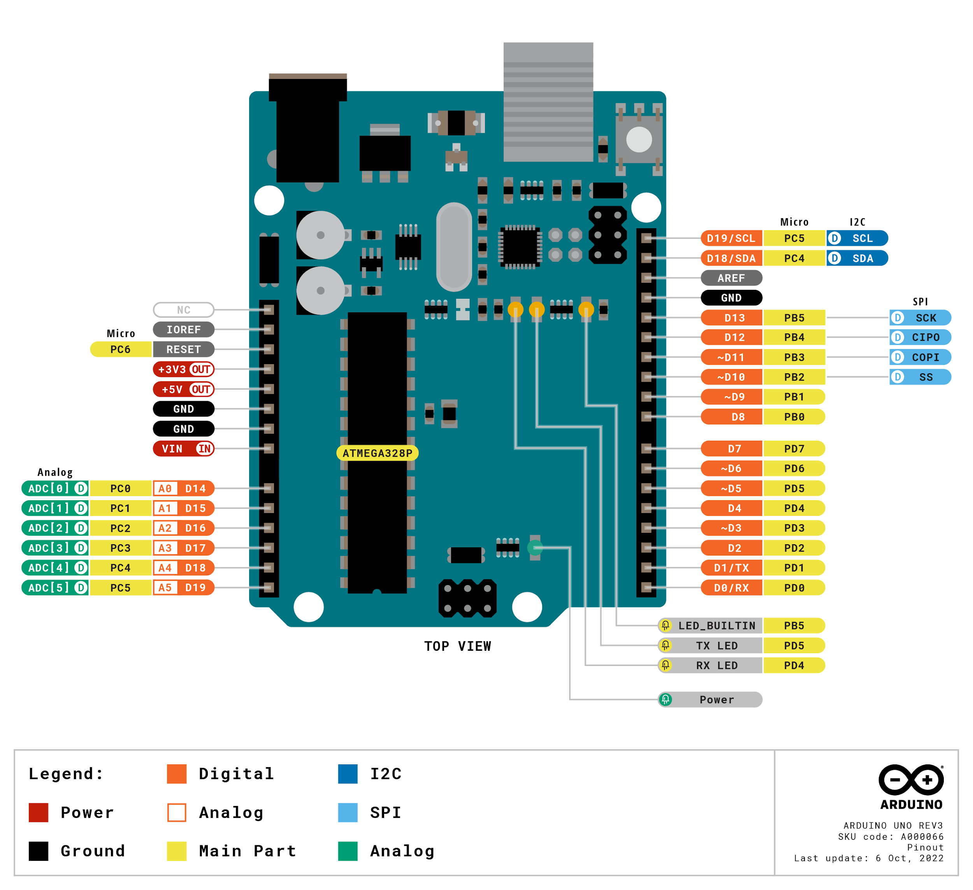
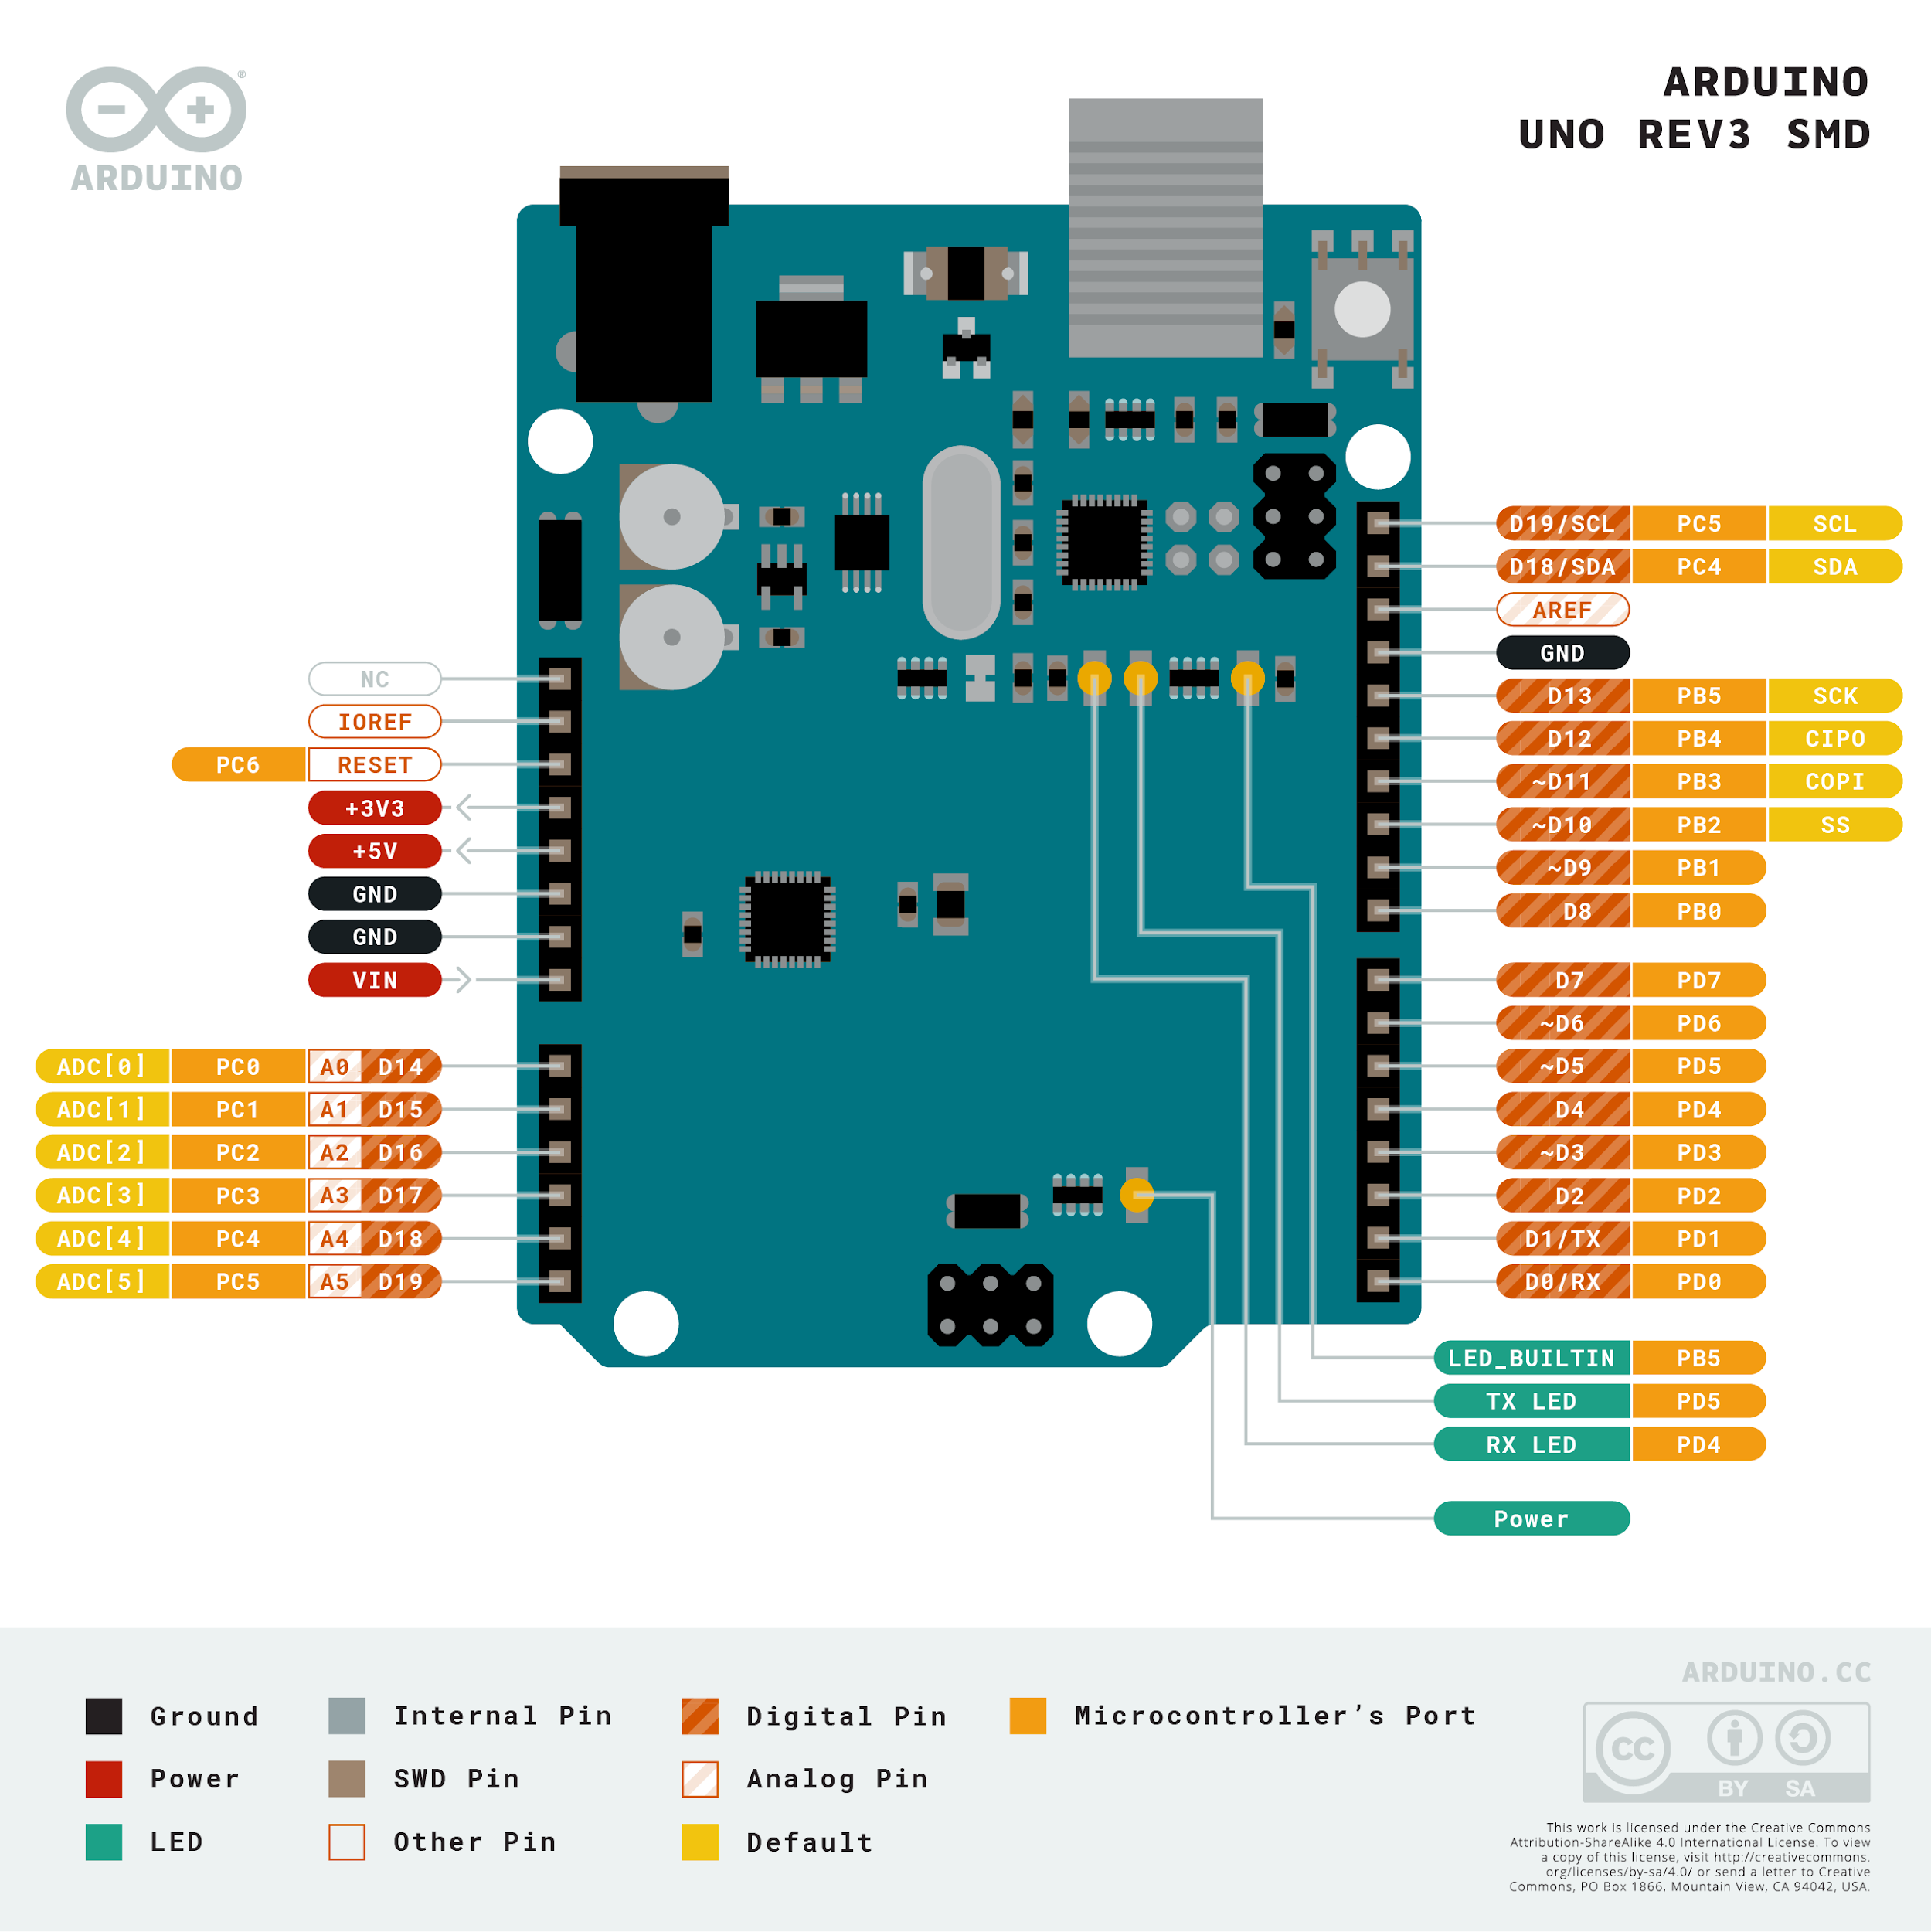
Hardware Overview

Slide 4
Software Overview
Arduino IDE
Firmata
Python
Tkinter
PyFirmata

Slide 5
Firmata
Firmata is a protocol for communicating with microcontrollers from software on a host computer. The protocol can be implemented in firmware on any microcontroller architecture as well as software on any host computer software package.

Slide 6
Tkinter
Tkinter is a standard library in Python for creating graphical user interfaces (GUIs). It provides a fast and straightforward way to create simple to complex GUI applications. Tkinter is built on the Tk GUI toolkit, a portable and lightweight library for creating GUIs that can run on many operating systems.

Slide 7
PyFirmata
PyFirmata is a Python library that provides an interface to the Firmata protocol, enabling software on a host computer to communicate with microcontrollers. By leveraging the Firmata protocol, PyFirmata allows developers to control microcontrollers like Arduino directly from Python scripts, without the need to write C or C++ code for the microcontroller itself. This library abstracts the Firmata protocol into Python methods and classes, making it accessible for Python developers to interact with hardware components, such as sensors, motors, and LEDs, in a more familiar programming environment.

Slide 8
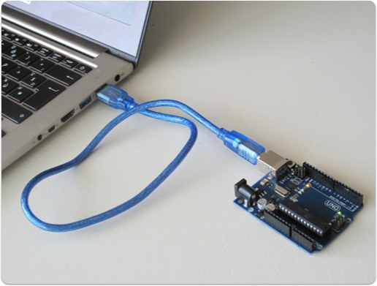
Schematic

